Slide 1
Welcome to Javascript

Slide 2
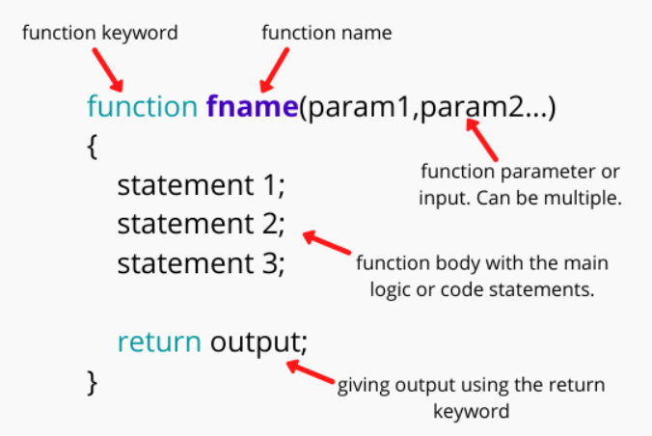
Function in JS
A function is a block of code that performs a specific task.
//defining a function
function <function-name>()
{
// code to be executed
};
//calling a function
<function-name>();
//defining a function
function ShowMessage() {
alert("Hello World!");
}
//calling a function
ShowMessage();

Slide 3
Function in JS
Function with parameters:
//defining a function
function ShowMessage(firstName, lastName) {
alert("Hello " + firstName + " " + lastName);
}
//calling a function
ShowMessage(“Ashok", “Kumar");
Function with Return Value:
//defining a function
function Sum(val1, val2) {
return val1 + val2;
};
//calling a function
var result = Sum(10,20); // returns 30

Slide 4
String Methods
length: Returns the number of characters in a string
replace(): method replaces a specified value with another value in a string
toUpperCase(): A string is converted to upper case
toLowerCase(): A string is converted to lower case
concat(): joins two or more strings, can be used instead of the plus operator
trim(): method removes whitespace from both sides of a string
charAt(): method returns the character at a specified index (position) in a string
indexOf(): method returns the position of the first occurrence of a specified value in a string, method returns -1 if the value is not found
Slice(): extracts a part of a string and returns the extracted part in a new string, method takes 2 parameters: the start position, and the end position
Substring(): is similar to slice(), difference is that substring() cannot accept negative indexes. omit the second parameter, substring() will slice out the rest of the string
split(): method divides a String into an ordered list of substrings and returns them as an array

Slide 5
String Methods
Example
let txt = “JavaScript";
let length = txt.length;
let text = “I am learning JavaScript";
let newText = text.replace(“learning", “working");
let text = "Please visit Madras, I love Madras!";
let newText = text.replace(/Madras/g, “Chennai");
let text1 = "Hello World!";
let text2 = text1.toUpperCase();
let text1 = "Hello World!"; // String
let text2 = text1.toLowerCase();
let text1 = "Hello";
let text2 = "World";
let text3 = text1.concat(" ", text2);
let text1 = " Hello World! ";
let text2 = text1.trim();
Example
let text = "HELLO WORLD";
let char = text.charAt(0);
const message = "JavaScript is fun";
// check the first occurrence of 'i' in message
let result = message.indexOf("i");
console.log(result);
str.indexOf(searchValue, fromIndex)
let str = "Apple, Banana, Kiwi";
let part = str.slice(7, 13);
let str = "Apple, Banana, Kiwi";
let part = str.substring(7, 13);
let part1 = str.substring(7);
let message = "JavaScript is fun";
let result = message.split(" ");

